Slide 1


Probability Theory and Exact Inference in Bayesian Networks
By: Aryeh Freud

Slide 2
Finite Probability
If S is a finite nonempty sample space of equally likely outcomes, and E is an event, that is, a subset of S, then the probability of E is$p\left(E\right)=\frac{\left|E\right|}{\left|S\right|}$
If S is a finite nonempty sample space of equally likely outcomes, and E is an event, that is, a subset of S, then the probability of E is 𝑝(𝐸)=|𝐸|/|𝑆|
According to Pierre-Simon Laplace’s definition, the probability of an event happening is between 0 and 1.

Slide 3
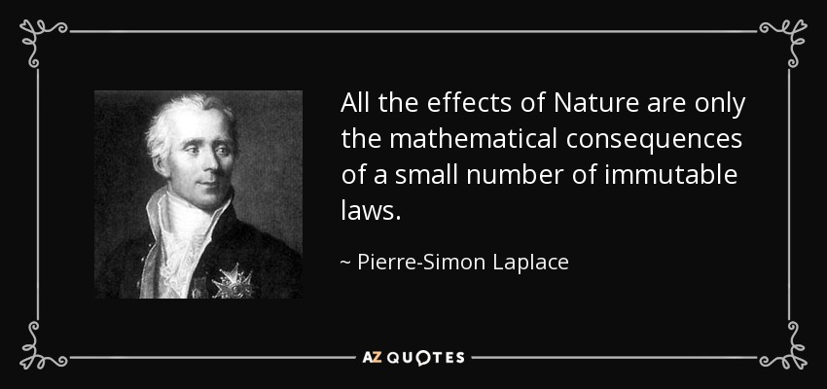
Pierre-Simon Laplace

Slide 4

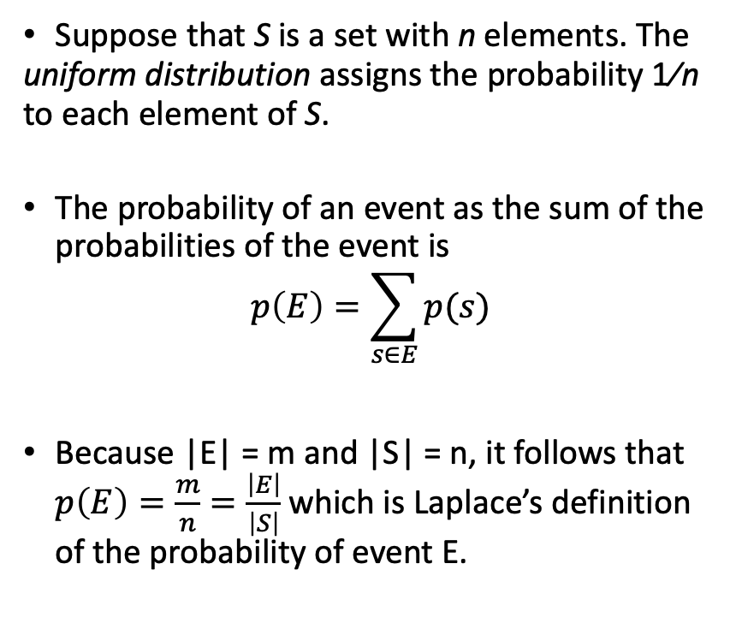
Assigning Probabilities
Suppose that S is a set with n elements. The uniform distribution assigns the probability 1∕n to each element of S.
The probability of an event as the sum of the probabilities of the event is
$$p\left(E\right)=\sum_{s∈E}{p(s)}$$
Because |E| = m and |S| = n, it follows that $p\left(E\right)=\frac{m}{n}=\frac{\left|E\right|}{\left|S\right|}$ which is Laplace’s definition of the probability of event E.

Slide 5
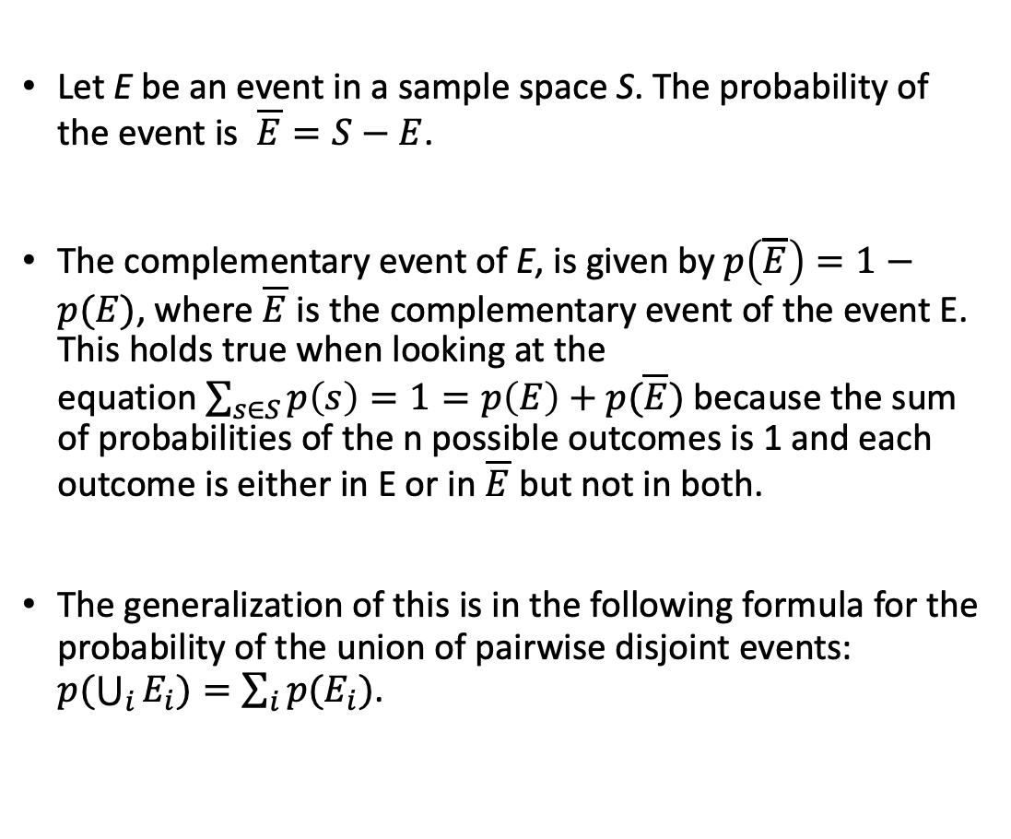
Probabilities of Complements and Unions of Events
Let E be an event in a sample space S. The probability of the event is $\overline{E}=S−E$.
The complementary event of E, is given by $p\left(\overline{E}\right)=1−p(E)$, where $\overline{E}$ is the complementary event of the event E. This holds true when looking at the equation$\sum_{s∈S}{p\left(s\right)=1=p\left(E\right)+p(\overline{E})}$ because the sum of probabilities of the n possible outcomes is 1 and each outcome is either in E or in $\overline{E}$ but not in both.
The generalization of this is in the following formula for the probability of the union of pairwise disjoint events: $p(\bigcup_{i}{E_{i})=\sum_{i}{p(E_{i})}}$.

Slide 6
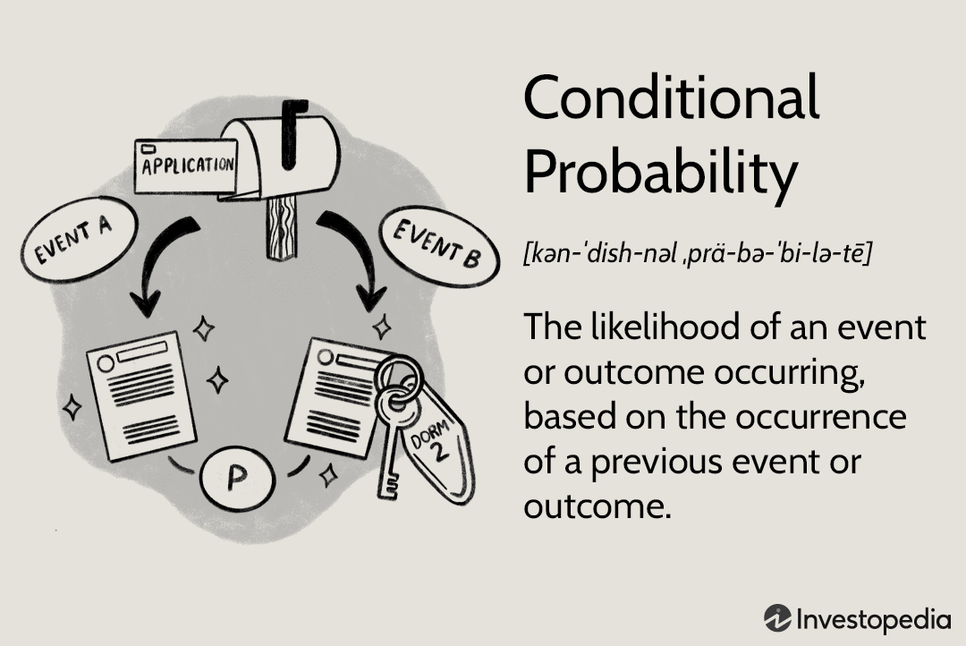
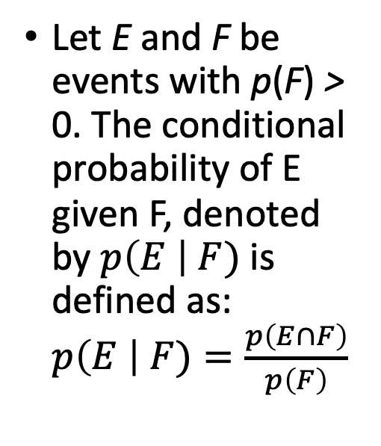
Let E and F be events with p(F) > 0. The conditional probability of E given F, denoted by $p\left(E \right| F)$ is defined as: $p\left(E \right| F)=\frac{p\left(E∩F\right)}{p\left(F\right)}$

Slide 7

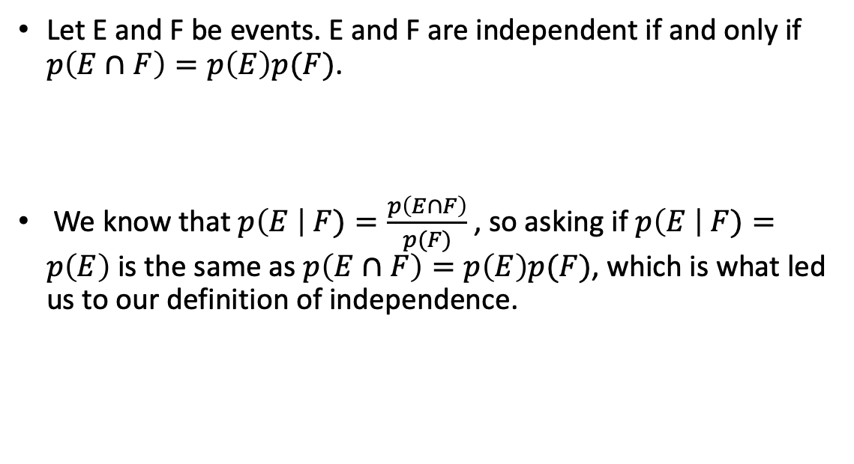
Independence
Let E and F be events. E and F are independent if and only if $p\left(E∩F\right)=p\left(E\right)p(F)$.
We know that $p\left(E \right| F)=\frac{p\left(E∩F\right)}{p(F)}$ , so asking if $p\left(E \right| F)=p\left(E\right)$is the same as $p\left(E∩F\right)=p\left(E\right)p(F)$, which is what led us to our definition of independence.

Slide 8

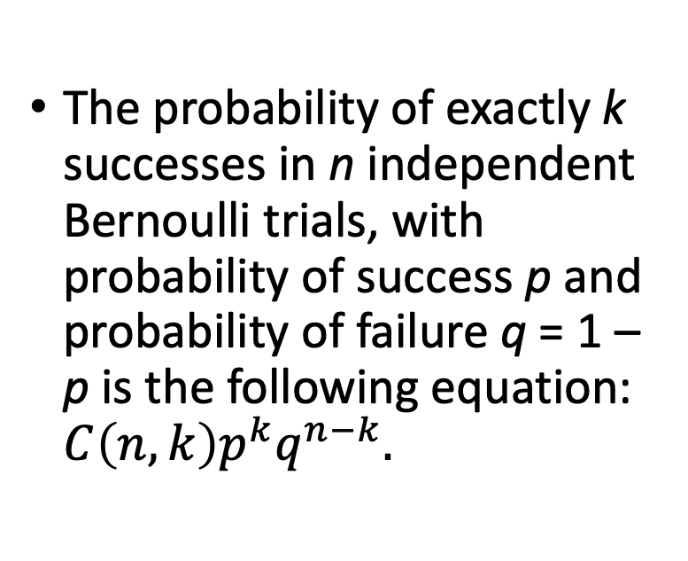
Bernoulli Trials
The probability of exactly k successes in n independent Bernoulli trials, with probability of success p and probability of failure q = 1 – p is the following equation: $C\left(n,k\right)p^{k}q^{n−k}.$

Slide 9

Background on Bernoulli
The law of large numbers:
If 𝜖 > 0, as n becomes arbitrarily large the probability approaches 1 that the fraction of times an event E occurs during n trials is within 𝜖 of p(E).

Slide 10
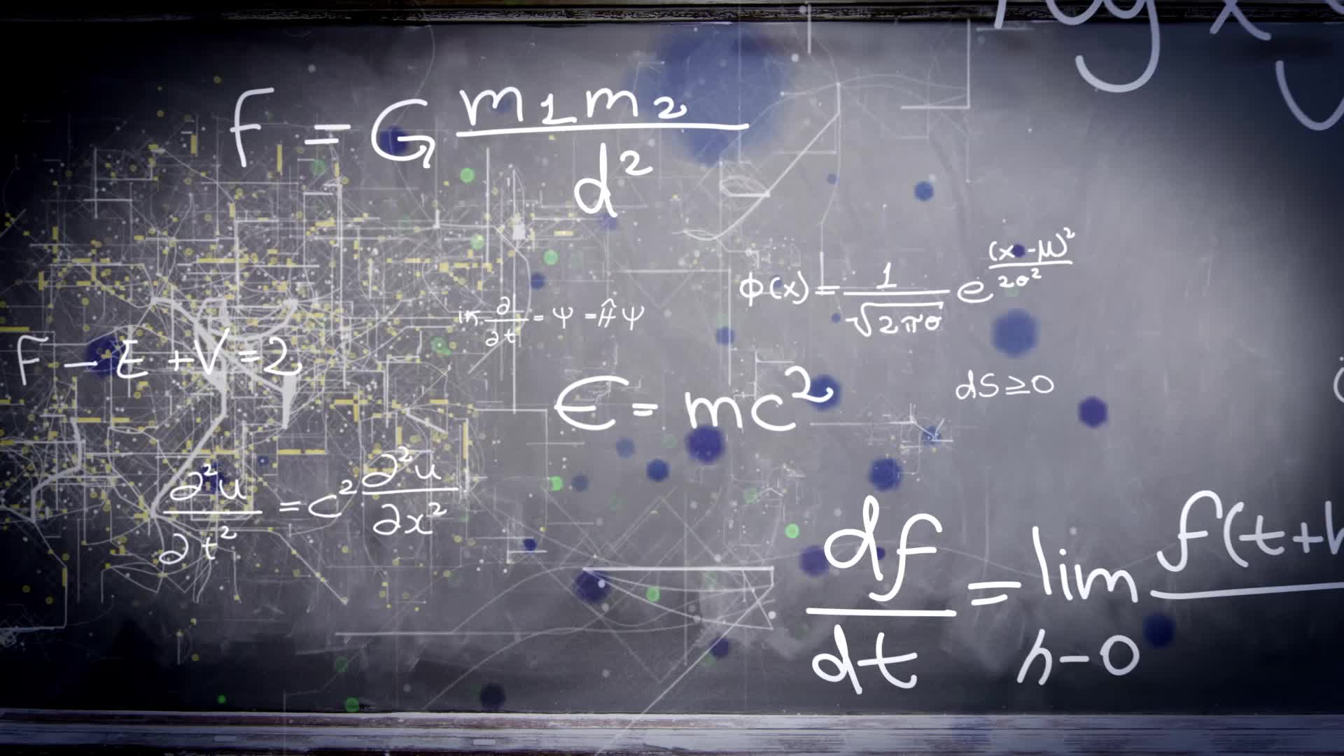
Random Variables
The distribution of a random variable X on a sample space S is the set of pairs (r, p(X = r)) for all r ∈ X(S), where p(X = r) is the probability that X takes the value r.

Slide 11

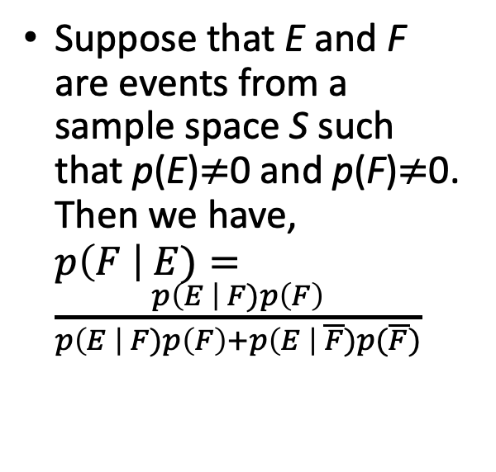
Bayes’ Theorem
Suppose that E and F are events from a sample space S such that p(E)$≠$0 and p(F)$≠$0. Then we have, $p\left(F \right| E)=\frac{p\left(E \right| F)p\left(F\right)}{p\left(E \right| F)p\left(F\right)+p\left(E \right| \overline{F})p(\overline{F})}$

Slide 12
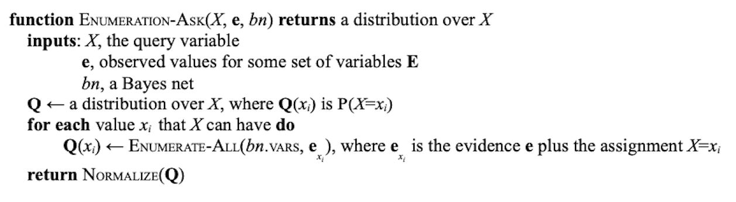
The Enumeration Algorithm - Ask Function

Slide 13
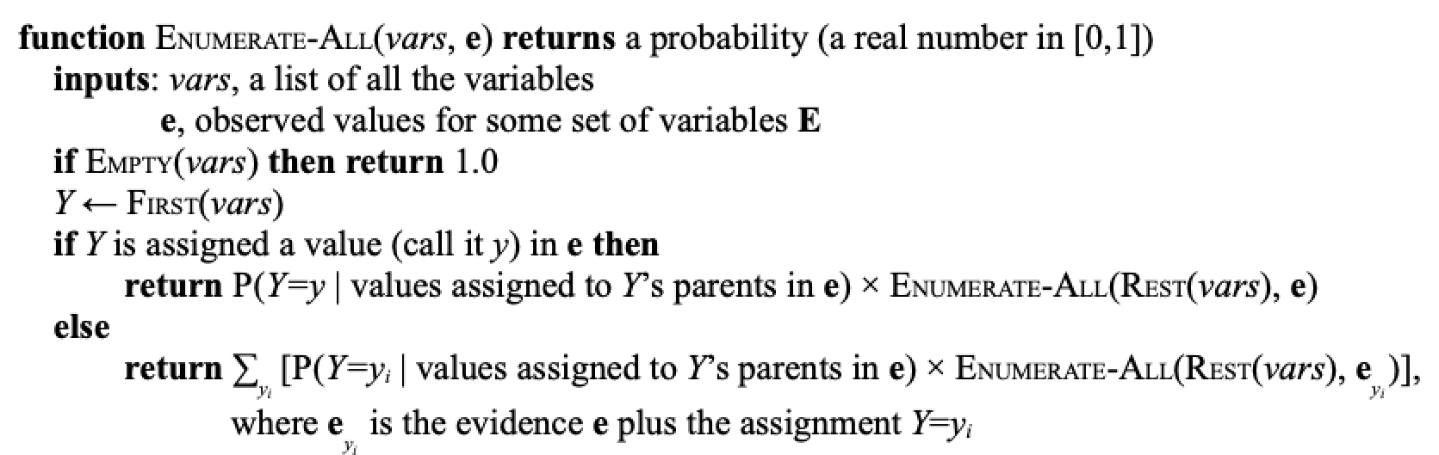
The Enumeration Algorithm – All Function

Slide 14
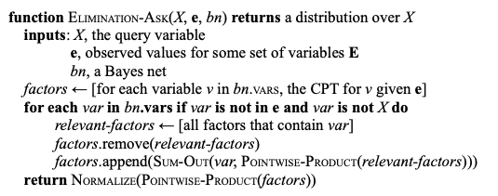
The Variable-Elimination Algorithm

Slide 15
Sources
Discrete Mathematics and Its Applications, 8th Edition By Kenneth H. Rosen
Exact Inference in Bayes Nets – Pseudocode from MIT’s Artificial Intelligence course (6.034)
Bayesian Network – www.wikipedia.com

